Slide 1
CSE 12 Week 7 Discussion
11-17-20
Focus: BST & Debugging

Slide 2
Reminders
PA7 (closed) due Tuesday, December 1st @ 11:59 PM
PA5 Resubmission due Friday, November 27th 11:59 PM
PA6 Resubmission due Friday, December 4th 11:59 PM

Slide 3
Binary Search Trees (BSTs)

Slide 4
Binary Search Tree (BST)
Binary Tree
Each node has at most 2 children (left child, right child)
Node Class
Key
Value
Left child
Right child
BST
Nodes belonging to the Left subtree have keys less than the parent node key, and nodes belonging to the right subtree have keys greater than the parent node key
class Node<K,V> {
K key;
V value;
Node<K,V> left, right;
public Node(K key, V value,
Node<K,V> left, Node<K,V> right) {
this.key = key;
this.value = value;
this.left = left;
this.right = right;
}
}

Slide 5

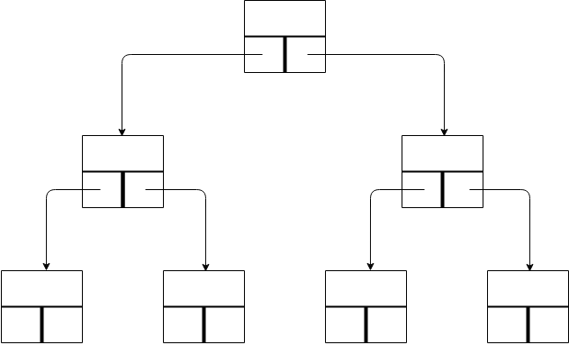
Helpful Terminology
root
Terminology
Root: the top node in the tree
Leaf: a node with no children
Breadth: the number of leaves
Depth: the distance between a node and the root
Level: 1 + depth
Subtree: a tree of node T and all of its descendants
Edge: the connection between one node and another
Height: number of edges on the longest path from the root to a leaf

Slide 6
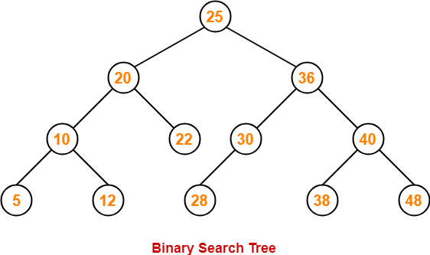
Example BST

Slide 7
Example BST

Slide 8
Example BST

Slide 9
Example BST

Slide 10
Methods for a BST (we can use the Map interface!)
put(K key, V value) | Adds the key-value pair to the BST
get(K key) | Returns the value corresponding to the given key
remove(K key) | Removes the entry corresponding to the given key
replace(K key, V newValue) | Replace the value that maps to the given key

Slide 11
BST Visualization
Link to good visualizations where you can create and execute your own examples:
https://www.cs.usfca.edu/~galles/visualization/BST.html

Slide 12
ideone.com
Where you can practice java (and other languages) with ease!

Slide 13
Debugging

Slide 14
Types of Errors
Compile Errors
Runtime Errors
Logic Errors
Notes:
Source: http://courses.cs.tau.ac.il/software1/0708b/misc/05-Debugging.v3.1.ppt

Slide 15
Compiler Error
Syntax error
Error in usage of Java
Detected by the compiler
A program with compilation errors cannot be run
Syntax warning
Warning message generated by the compiler
The program can be run

Slide 16
Compiler Errors
Very common (but sometimes hard to understand). Examples of syntax errors:
Forgetting a semicolon
Leaving out a closing bracket }
Redeclaring a variable
Others?

Slide 17
Compiler Errors
Hints to help find/fix compiler errors:
Compiler errors are cumulative: when you fix one, others may go away
Read the error messages issued by the compiler!
Realize that the error messages from the compiler are often (seemingly) not very helpful
The compiler does not know what you intended to do, it merely scans the Java code

Slide 18
Runtime Errors
Runtime error: program runs but gets an exception error message
Program may be terminated
Runtime errors can be caused by
Program bugs
Bad or unexpected input
Hardware or software problems in the computer system

Slide 19
Runtime Errors
Very common runtime errors are:
null reference (NullPointerException)
no object is referenced by the reference variable, i.e. it has the value null
array index out of bounds (ArrayIndexOutOfBoundsException)
Running out of memory
e.g. from creating a new object every time through an infinite loop

Slide 20
Runtime Errors
Hints to help find/fix runtime errors:
Check the exception message for the method and line number from which it came
Note that the line in the code that caused the exception may not be the line with the error
Example: consider the code segment
int [] nums = new int[10];
for (int j=0; j<=10; j++)
nums[j] = j;
The exception will be at the line
nums[j] = j;
but the error is in the previous line

Slide 21
Logic Errors
Logic error: program runs but results are not correct
Logic errors can be caused by:
incorrect algorithms

Slide 22
Logic Errors
Very common logic errors are:
using == instead of the equals method
infinite loops
misunderstanding of operator precedence
starting or ending at the wrong index of an array
If index is invalid, you would get an exception
misplaced parentheses (so code is either inside a block when it shouldn’t be, or vice versa)

Slide 23
Logic Errors
Be careful of where you declare variables!
Keep in mind the scope of variables
Instance variables?
Formal parameters?
Local variables?
Example:
private int numStudents; // an attribute, to be
// initialized in some method
…
public void someMethod(){
int numStudents = …; // not the attribute!
…
}

Slide 24
Testing vs Debugging
Testing: to identify any problems before software is put to use
“Testing can show the presence of bugs but can never show their absence”.
Debugging: locating bugs and fixing them

Slide 25
Debugging Strategies
Trace your code by hand
Add main method to the class
Add print statements to your code

Slide 26
Debuggers
All Integrated Development Environments have an interactive debugger feature
You can single-step step through your code (one statement at a time)
You can see what is stored in variables
You can set breakpoints
You can “watch” a variable or expression during execution

Slide 27
Eclipse Debugger
Having System.out.println() statements in our code allows us to examine values of variables/fields at a given point. This is the old fashioned way of debugging code.
Eclipse’s built in debugger allows us to set breakpoints on lines in our code. Your program will “pause (break)” when it reaches the line with a breakpoint. Eclipse allows you to examine variables/fields/modify values and you can “continue” your program.
https://www.vogella.com/tutorials/EclipseDebugging/article.html

Slide 28
Eclipse Debugger
1. Add breakpoints: double-click the blue bar on the left side of Edit window or right click on the bar and select “toggle breakpoint”. A blue dot indicates a breakpoint. To remove a break point, double click the breakpoint.
2. Select Run->Debug as...->Java Application to start the debugger.
3. Click on Run and then try the debug commands to see what they do and see how the values of the variables change in the Variable window and what the outputs are in the Console window.
4. Switch Eclipse from Debug Perspective back to Java Perspective.

